Slide 1
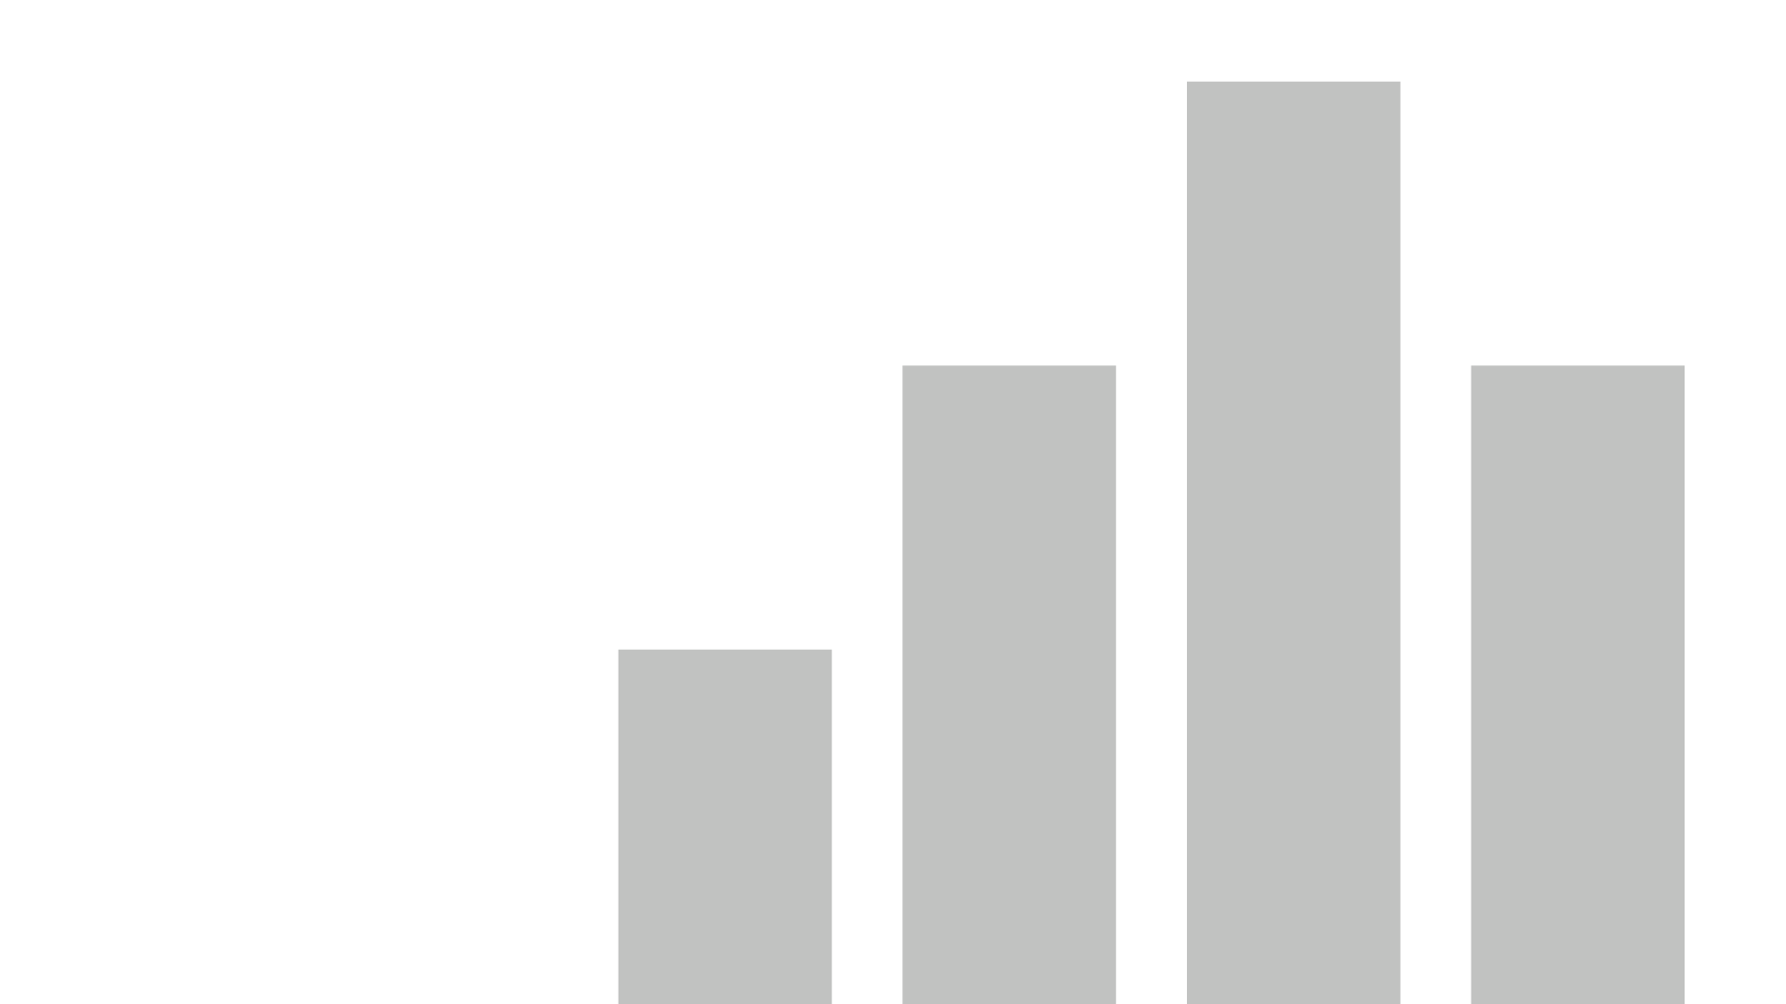


Data Analysis And Visualization (Power BI and Power App)
View in Power BI
Last data refresh:
8/22/2022 6:20:57 AM UTC
Downloaded at:
8/23/2022 4:33:02 AM UTC

Slide 2
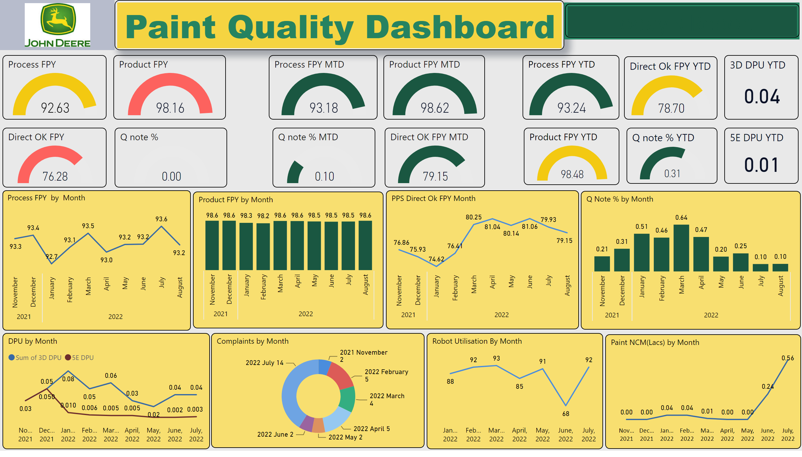
Paint Quality Dashboard
Notes:
Power BI report for Paint Quality Metrics Summary – Auto shared to all stake holders through Mail on daily basis
Complaints by Month
No alt text provided
DPU by Month
No alt text provided
Robot Utilisation By Month
No alt text provided
lineChart
No alt text provided
Q Note % by Month
No alt text provided
PPS Direct Ok FPY Month
No alt text provided
Product FPY by Month
No alt text provided
Process FPY by Month
No alt text provided
3D DPU YTD
No alt text provided
5E DPU YTD
No alt text provided
Direct Ok FPY YTD
No alt text provided
Q note % YTD
No alt text provided
Paint Quality Dashboard
No alt text provided
image
No alt text provided
slicer
No alt text provided
Product FPY
No alt text provided
Q note %
No alt text provided
Direct OK FPY
No alt text provided
Process FPY
No alt text provided
Product FPY MTD
No alt text provided
Process FPY MTD
No alt text provided
Q note % MTD
No alt text provided
Direct OK FPY MTD
No alt text provided
Process FPY YTD
No alt text provided
Product FPY YTD
No alt text provided
Today's Report
No alt text provided

Slide 3
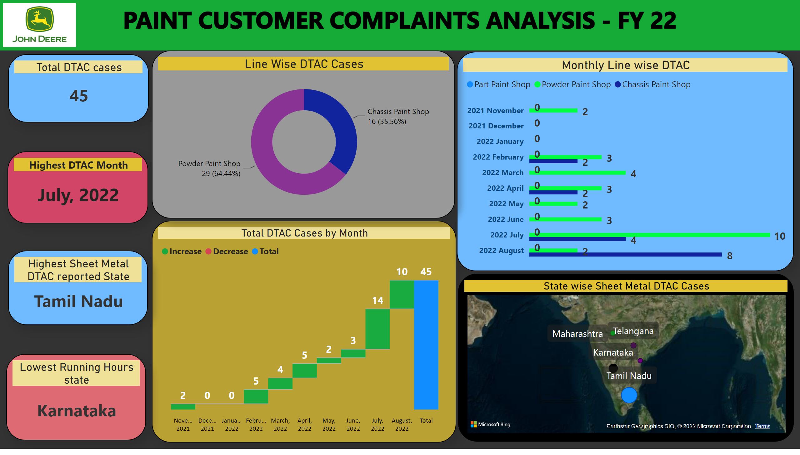
Customer Complaints Analysis
Notes:
Total DTAC Cases by Month
No alt text provided
Monthly Line wise DTAC
No alt text provided
Highest DTAC Month
No alt text provided
State wise Sheet Metal DTAC Cases
No alt text provided
Total DTAC cases
No alt text provided
Line Wise DTAC Cases
No alt text provided
Highest Sheet Metal DTAC reported State
No alt text provided
Lowest Running Hours state
No alt text provided
PAINT
No alt text provided
image
No alt text provided

Slide 4
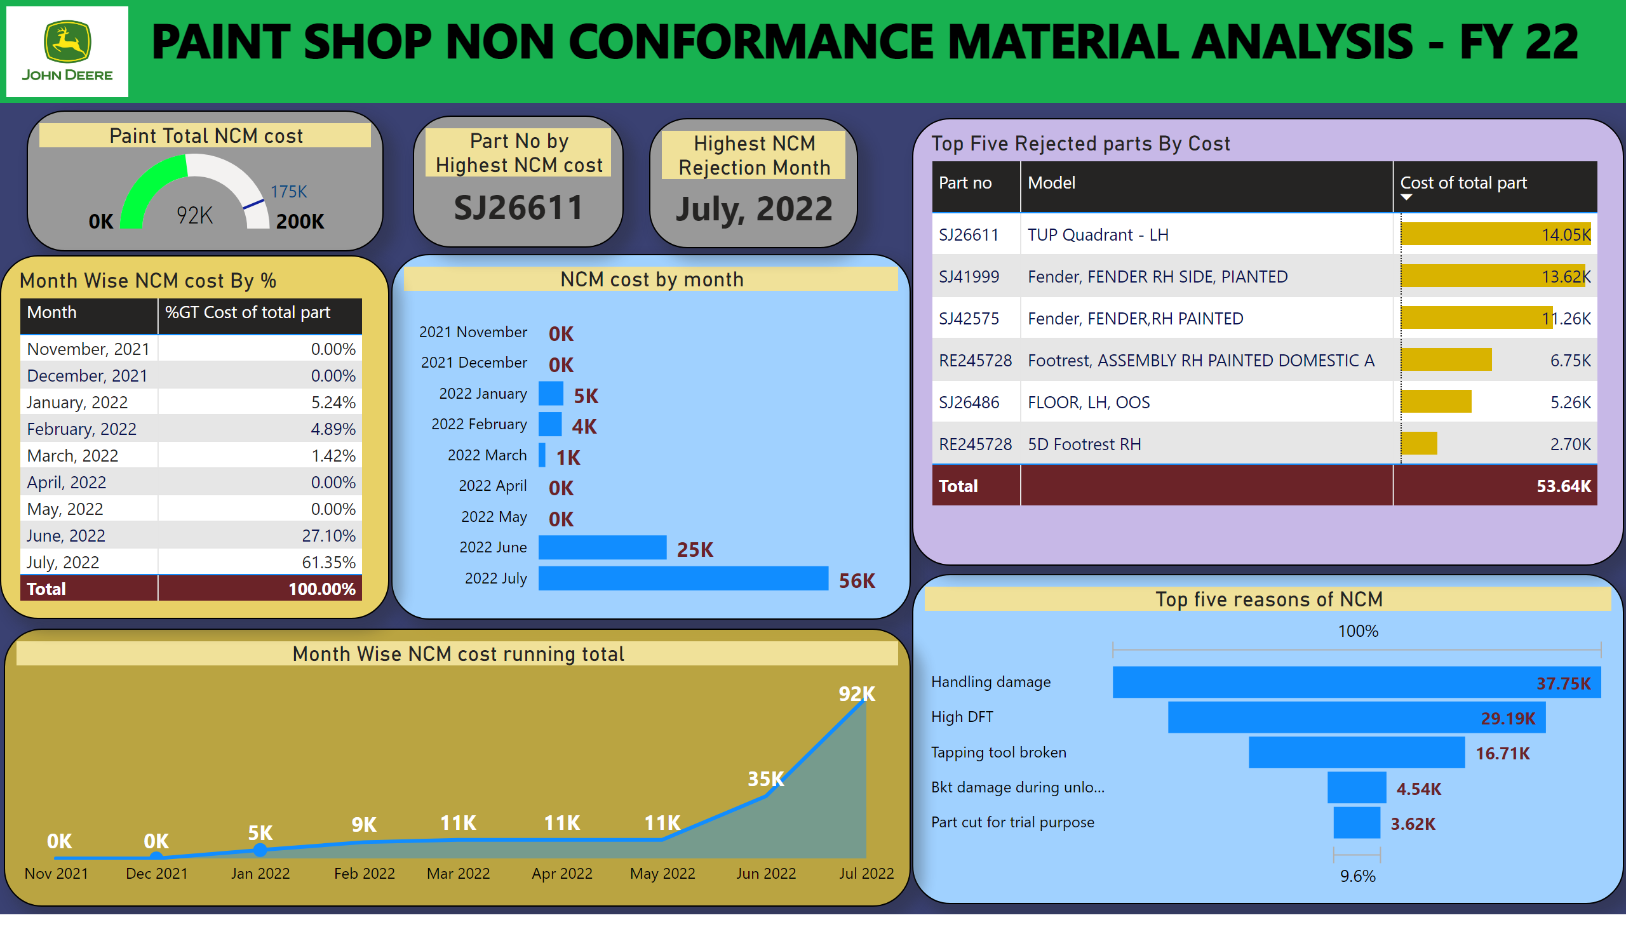
Paint NCM Analysis
Notes:
PAINT
No alt text provided
image
No alt text provided
Paint Total NCM cost
No alt text provided
NCM cost by month
No alt text provided
Part No by Highest NCM cost
No alt text provided
Highest NCM Rejection Month
No alt text provided
Top five reasons of NCM
No alt text provided
Month Wise NCM cost running total
No alt text provided
Top Five Rejected parts By Cost
No alt text provided
Month Wise NCM cost By %
No alt text provided

Slide 5
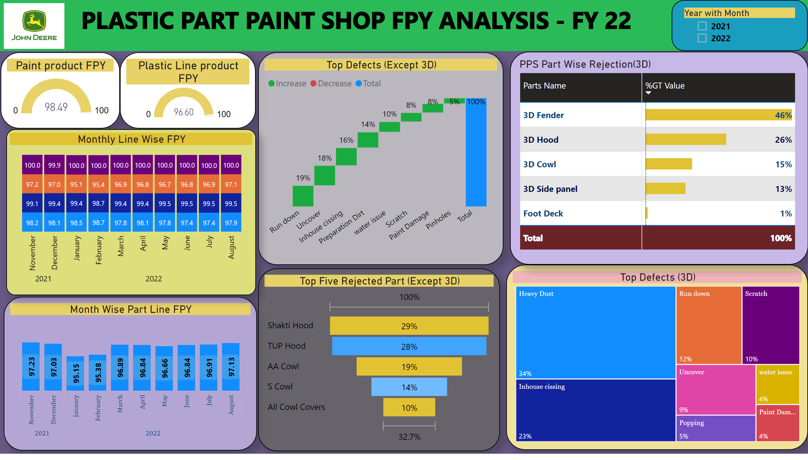
Part Line Analysis
Notes:
PAINT
No alt text provided
image
No alt text provided
Paint product FPY
No alt text provided
Plastic Line product FPY
No alt text provided
Month Wise Part Line FPY
No alt text provided
Top Defects (Except 3D)
No alt text provided
slicer
No alt text provided
Top Five Rejected Part (Except 3D)
No alt text provided
Top Defects (3D)
No alt text provided
PPS Part Wise Rejection(3D)
No alt text provided
Monthly Line Wise FPY
No alt text provided

Slide 6
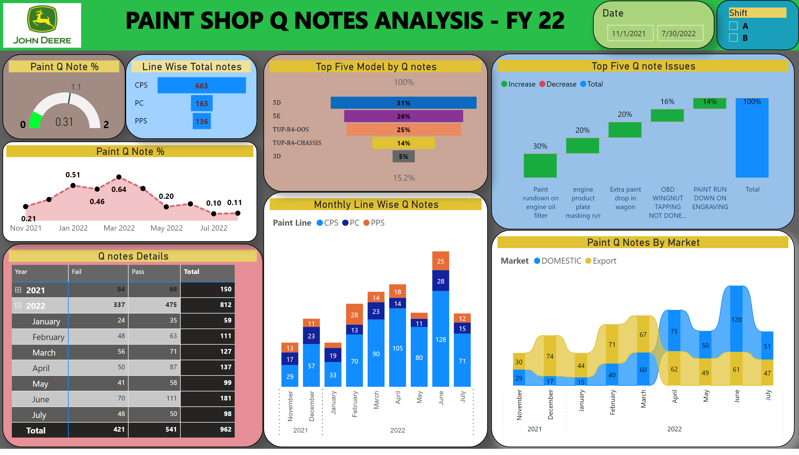
Paint Q note Analysis
Notes:
PAINT
No alt text provided
image
No alt text provided
Paint Q Note %
No alt text provided
Q notes Details
No alt text provided
Paint Q Note %
No alt text provided
Line Wise Total notes
No alt text provided
Monthly Line Wise Q Notes
No alt text provided
Top Five Q note Issues
No alt text provided
Paint Q Notes By Market
No alt text provided
slicer
No alt text provided
Top Five Model by Q notes
No alt text provided
Date
No alt text provided

Slide 7
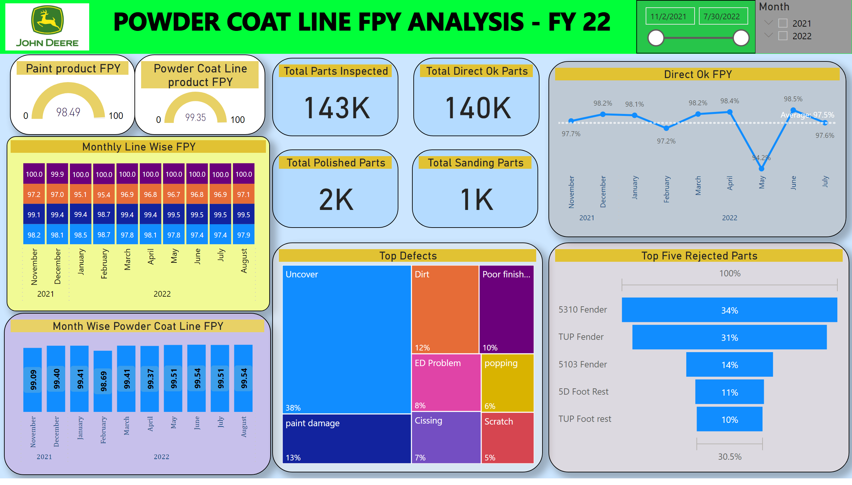
Powder Line Analysis
Notes:
PAINT
No alt text provided
image
No alt text provided
Paint product FPY
No alt text provided
Powder Coat Line product FPY
No alt text provided
Monthly Line Wise FPY
No alt text provided
Month Wise Powder Coat Line FPY
No alt text provided
Direct Ok FPY
No alt text provided
Top Defects
No alt text provided
Top Five Rejected Parts
No alt text provided
Total Parts Inspected
No alt text provided
Total Direct Ok Parts
No alt text provided
Total Polished Parts
No alt text provided
Total Sanding Parts
No alt text provided
slicer
No alt text provided
Month
No alt text provided

Slide 8

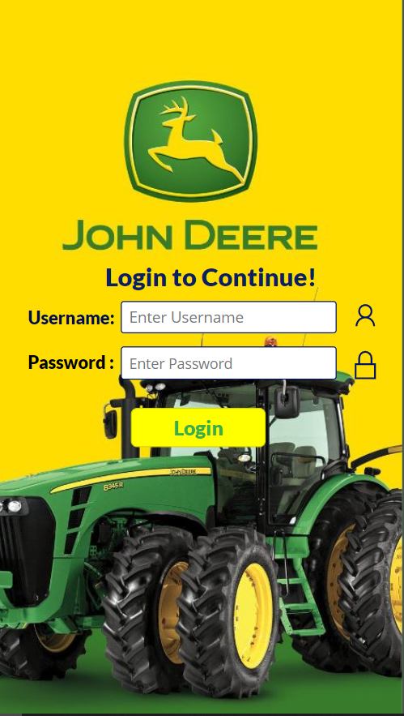
Power APP Developed for above Data Visualization Access through Web on Desktop/Mobile App
Web Link :- https://apps.powerapps.com/play/85b412a8-1ae9-48af-b1e1-bdb599a1f384?tenantId=39b03722-b836-496a-85ec-850f0957ca6b
Login Page
Username – Paint
Password - Johndeere
App Image

